Slide 1

Evaluation of Rust language for Embedded Systems in terms of Security, Usability, and Performance
Ankita Kumari ge93vep@mytum.de Advisor: Andreas Finkenzeller Department of Electrical and Computer Engineering
Technical University of Munich

Slide 2
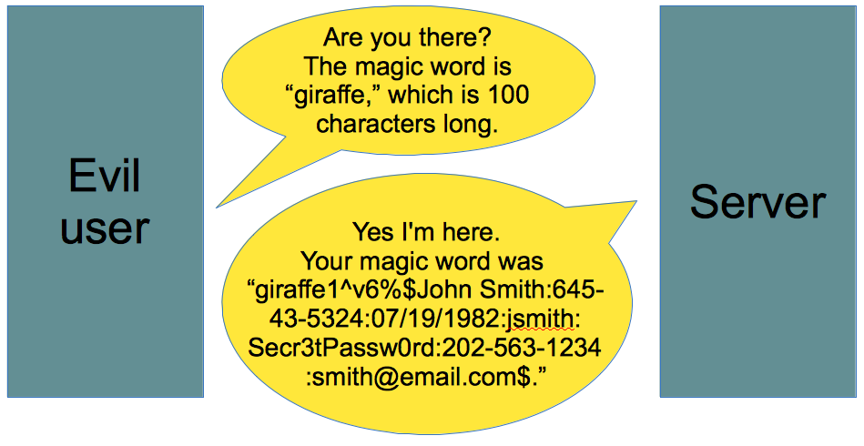



Introduction
The Heartbleed Vulnerability [1]
C for Embedded Systems
Example of Buffer overread [2]

Slide 3



Motivation
Defense mechanism
Address Space Layout Randomisation
Data Execution Prevention
Secure Coding
Performance overhead
Portable
Garbage Collector
Does not port to assembly
Memory safety
Bad cross-compiling

Slide 4

Aim
Rust [4]
Evaluate claims of Rust for Embedded Systems
Security provided by Rust
Performance of Rust compared to C
Compatibility of Rust with C libraries (Usability)
Low-level control
Speed
High level
Memory safety

Slide 5
Introduction to Rust
Works for embedded programming:
Produces predictable assembly
No garbage collection
Memory Safety
Type Safety
Error Handling
Ownership | Every value in Rust has a single owner at a given time
Borrowing | Used to pass the reference but keep the ownership
Mutability | Immutable by default. Makes sharing of data easier. Prevents overwriting
Lifetime | A variable only lives in its defined scope

Slide 6
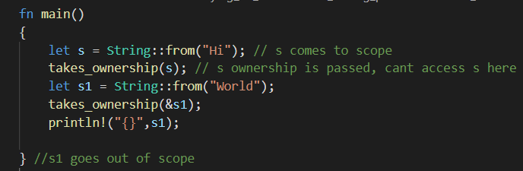

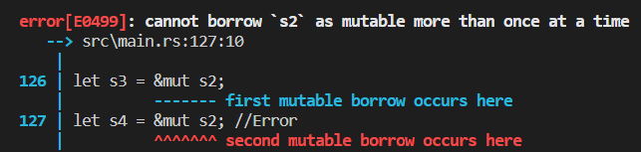
Ownership, Borrowing and Lifetime
Memory Safety
Data Race Freedom

Slide 7
Security vulnerabilities in Embedded System
Vulnerabilities
Vulnerabilities
Software Attacks
Hardware Attack
Software Attacks
Hardware Attack
Double Free
Buffer Overflow
Invasive Attacks
Non-Invasive Attacks
Invasive Attacks
Use after Free
Reverse Engineering
Side Channel Attacks
Microprobing
DPA

Slide 8
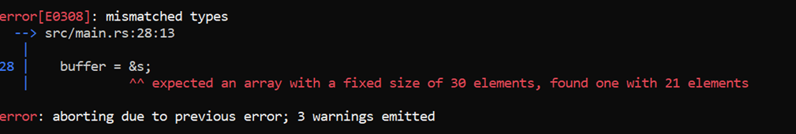
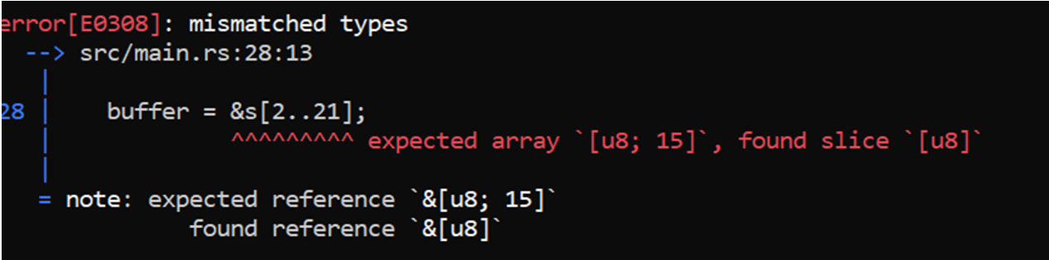
Software Attacks - Buffer Overflow
let mut a: [char; 2] = ['1', '2'];
let b: [char; 3] = ['1', '2', '3'];
a.copy_from_slice(&b);
Rust panics and terminates the program.
let buffer : [u8;30];
let s: [u8;21];
buffer = &s;
buffer = &s[2..21]

Slide 9
Heartbleed Vulnerability in Rust
If payload size larger than the buffer pl, additional data was copied to the buffer bp.
3+payload is the upper index of the slice to be copied.
Rust will panic if tried to access out of bound value from p. [2]
memcpy(bp, pl, payload);
let payload:usize = ((p[1] as usize) << 8) + p[2] as usize; //p is the user input string
let mut bp: [u8;payload+PADDING]; //needs constant size of array
bp.extend(p[3..3+payload].iter().cloned()); //copy of payload string happens here.

Slide 10
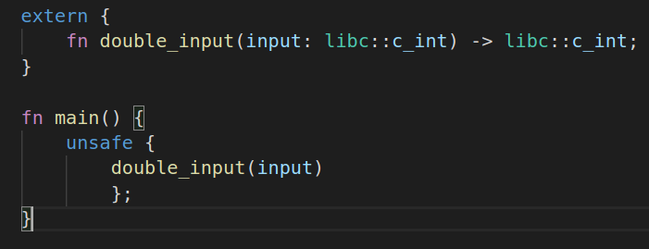
Memory Exploits Using Unsafe Keyword
Calling functions from other languages
Bypass the compiler checks
Interact with hardware
Unsafe Keyword
1. Raw Pointer dereferencing
unsafe allows dereferencing the pointer even when it is freed
let p;
{
let mut x: u8 = 1;
p = x as *const i32;
} // x goes out of scope here
let c = p;
unsafe{
hprintln!("{}",*p);
}
Unsafe Keyword

Slide 11
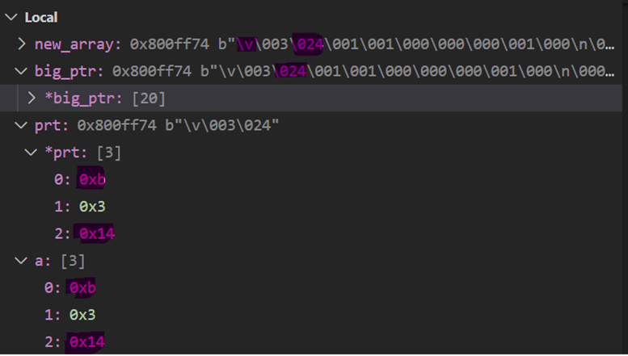
Buffer Overread and Immutability
2. Overread
3. Immutability
let mut a: [u8; 3] = [2,3,4];
let prt: *mut [u8;3] = &mut a;
let big_ptr: *mut [u8;20] = prt as *mut [u8;20];
unsafe {
let mut new_array: [u8;20] = *big_ptr;
new_array[10] = 10;
}
let a: [u8; 3] = [2,3,4];
let prt: *const [u8;3] = &a;
let big_ptr: *mut [u8;20] = prt as *mut [u8;20];
unsafe {
let mut new_array: &mut [u8;20] = &mut *big_ptr;
new_array[0] = 11;
}
*big_ptr copy the contents of big_ptr to new_array. Overread by reading the memory past the length of a

Slide 12
Security vulnerabilities in Embedded System
Vulnerabilities
Vulnerabilities
Software Attacks
Hardware Attack
Software Attacks
Hardware Attack
Double Free
Buffer Overflow
Invasive Attacks
Non-Invasive Attacks
Invasive Attacks
Use after Free
Reverse Engineering
Side Channel Attacks
Microprobing
DPA

Slide 13
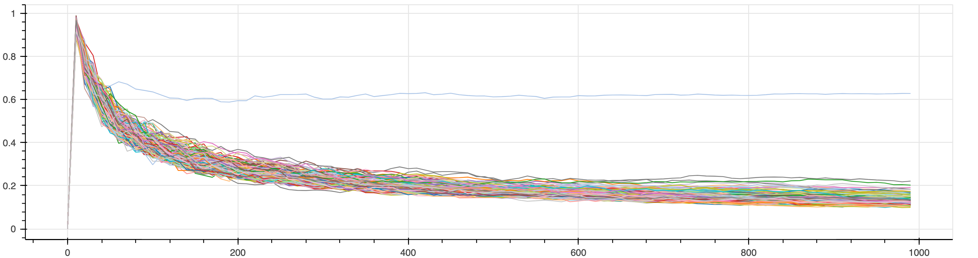
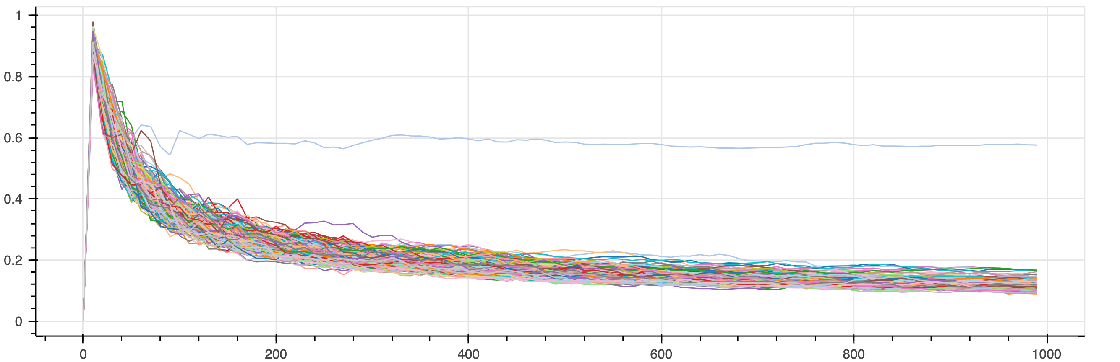
Non-Invasive Attacks - DPA
Power analysis of 255 different values of the key position 0 for 1000 traces
Rust
C
No additional safety against the side-channel attacks
Key read out in less than 100 power traces.

Slide 14
Security vulnerabilities in Embedded System
Vulnerabilities
Vulnerabilities
Software Attacks
Hardware Attack
Software Attacks
Hardware Attack
Double Free
Buffer Overflow
Invasive Attacks
Non-Invasive Attacks
Invasive Attacks
Use after Free
Reverse Engineering
Side Channel Attacks
Microprobing
DPA

Slide 15
Secure Coding patterns against Invasive Attacks
Secure Boolean
Non-zero values result in True
255 possibilities to flip a bit and bypass a check
Solution
Same hamming weight and hamming distance
Use volatile
enum SecBool {
SecTrue = 0x9999, \\Hamming Weight(HW)=8 SecFalse = 0x3C3C, \\ HW = 8
SecInit = 0x5A5A \\ HW = 8
}
match unsafe { *core::ptr::read_volatile(&val)}
{
SecBool::SecTrue=> hprintln!("TRUE“),
SecBool::SecFalse =>hprintln!("FALSE),
_ => panic!()
};

Slide 16
Secure Return parameter
Secure Return parameter
Skipping the assembly instruction bl
The previous value of r0 moved to variable
Solution
Pass by reference
Skip the mov password, r0 command
Secure Loop
Secure Branch Handling
movs r0, #20
bl check_password
mov password, r0
movs r0, sp, #8
bl check_password
In check_password
mov r4, r0 //r0 contains address
movs r0, #5
str r0, [r4]

Slide 17
Performance Evaluation
AES algorithm → Used for the performance evaluation
Evaluation is done based on
Clock Cycles
NVM Size
Stack Size
Optimization Level | O0, O1, O2, O3, Os, Oz

Slide 18
Evaluation of Clock cycles and NVM Size

Slide 19
CPU Cycles varying with NVM Size

Slide 20
Stack Usage

Slide 21
Discussion
 | Security |  | Performance |  |  | Usability
 | Software Attacks | Hardware attacks | Execution Speed | NVM Size | RAM consumption | Inter-portability | Embedded Support | Learning Curve
Rust | ++ | - | ++ | - | ++ | ++ | ++ | -
C | -- | - | + | + | + | ++ | + | ++

Slide 22
Conclusion
Security
Prevents memory exploits.
Unsafe → vulnerabilities, review time.
HW attacks → secure coding patterns
Performance
Stack usage (Higher execution speed and NVM size)
O3 better speed at constant NVM size
Usability
Interportable with C
Support for Embedded System
Reduces testing and review time
“Rust is a secure substitute for C for Embedded Software Development”

Slide 23
Future work
Implementing further randomization in the AES algorithm
Analysis of Oz optimization level
Dynamic memory allocation and run-time checks
Using Rust for multi-threaded programming

Slide 24
References
[1] “The Heartbleed Bug”, https://heartbleed.com/#:~:text=The%20Heartbleed%20Bug%20is%20a,used%20to%.
[2] “Buffer Overread“ https://www.vox.com/2014/6/19/18076318/heartbleed
[3] “CWE Top 25 Dangerous Software Weakness”, https://cwe.mitre.org/top25/archive/2020/2020_cwe_top25.html
[4] ‘The Rust Programming Language’. [Online]. Available: https://doc.rustlang.org/book/.
[Accessed: 17-Feb-2016].

Slide 25

Questions?

Slide 26
Software Vulnerabilities
Software attacks are carried out on the system by executing a piece of code to take control of the device
Buffer Overflow Attacks
Double Free
Use after free
Null Pointer

Slide 27
Hardware Attacks
Non-Invasive Attacks:
No harm to the device
No prerequisite knowledge.
Side Channel Attacks
Eavesdropping
A Differential Power Analysis attack is performed on the AES implementation with Rust and compared with C.

Slide 28
Invasive Attacks
Hardware attacks that require physical manipulations on semiconductors are called invasive attacks. They are very powerful than non invasive attacks but expensive
Reverse Engineering
Microprobing
Laser Attack
For invasive attacks, the assembly code was analysed and some of the secure coding methods were implemented in Rust that helped prevent some prevailing attacks

Slide 29
Secure Return parameter
Secure Return parameter
The return value is stored in a register and moved from the register to the variable
The attacker can skip the assembly instruction „bl“.
The previous/random value of r0 moved to this variable
Solution
Passing the value by reference.
Skip the „mov password, r0“ command.
movs r0, #20
bl check_password
mov password, r0
movs r0, sp, #8
bl check_password
In check_password
mov r4, r0 //r0 contains address
movs r0, #5
str r0, [r4]

Slide 30
Secure Branch handling
Program branches can be skipped easily with a physical attack and normal flow execution is continued, leading to skipping of certain checks.
If password == 777
{
//Give admin rights
}
The attacker can flip the output of the compare assembly code to branch to equal even when not equal.
Solution
The comparison should be done again inside the branch to make sure the comparison is still valid and there was no attack
cmp r7, #777
bneq security_alert()
str r4, [sp,10]

Slide 31
Secure Branch handling
Flip the output of the cmp
Solution
The comparison should be done again inside the branch to make sure the comparison is still valid and there was no attack
if password == 777
{
//Give admin rights
}
cmp r7, #777
bneq security_alert()
str r4, [sp,10]

